Slide 1
CSE 417T Introduction to Machine Learning
Lecture 9 Instructor: Chien-Ju (CJ) Ho

Slide 2
Logistics
Homework 2 is due on October 7 (Friday)
Return of homework
We plan to return each homework within 1.5~2 weeks after the deadline
Regrade requests
You will have up to 7 days to submit regrade requests
the regrade period might be shortened if there are schedule constraints
We might check the entire homework for each request, so the grades might go down as well if we find new mistakes
Exam 1: October 27 (Thursday)
Content: LFD Chap 1 to 5 (The entire hardcopy of the textbook)
Timed exam (75 min) during lecture time (location TBD)
Closed-book exam with 2 letter-size cheat sheets (4 pages in total)
No format limitations (it can be typed, written, or a combination)

Slide 3
Recap

Slide 4
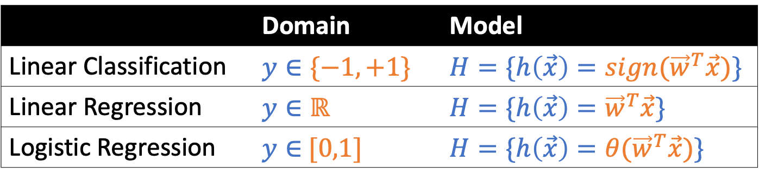
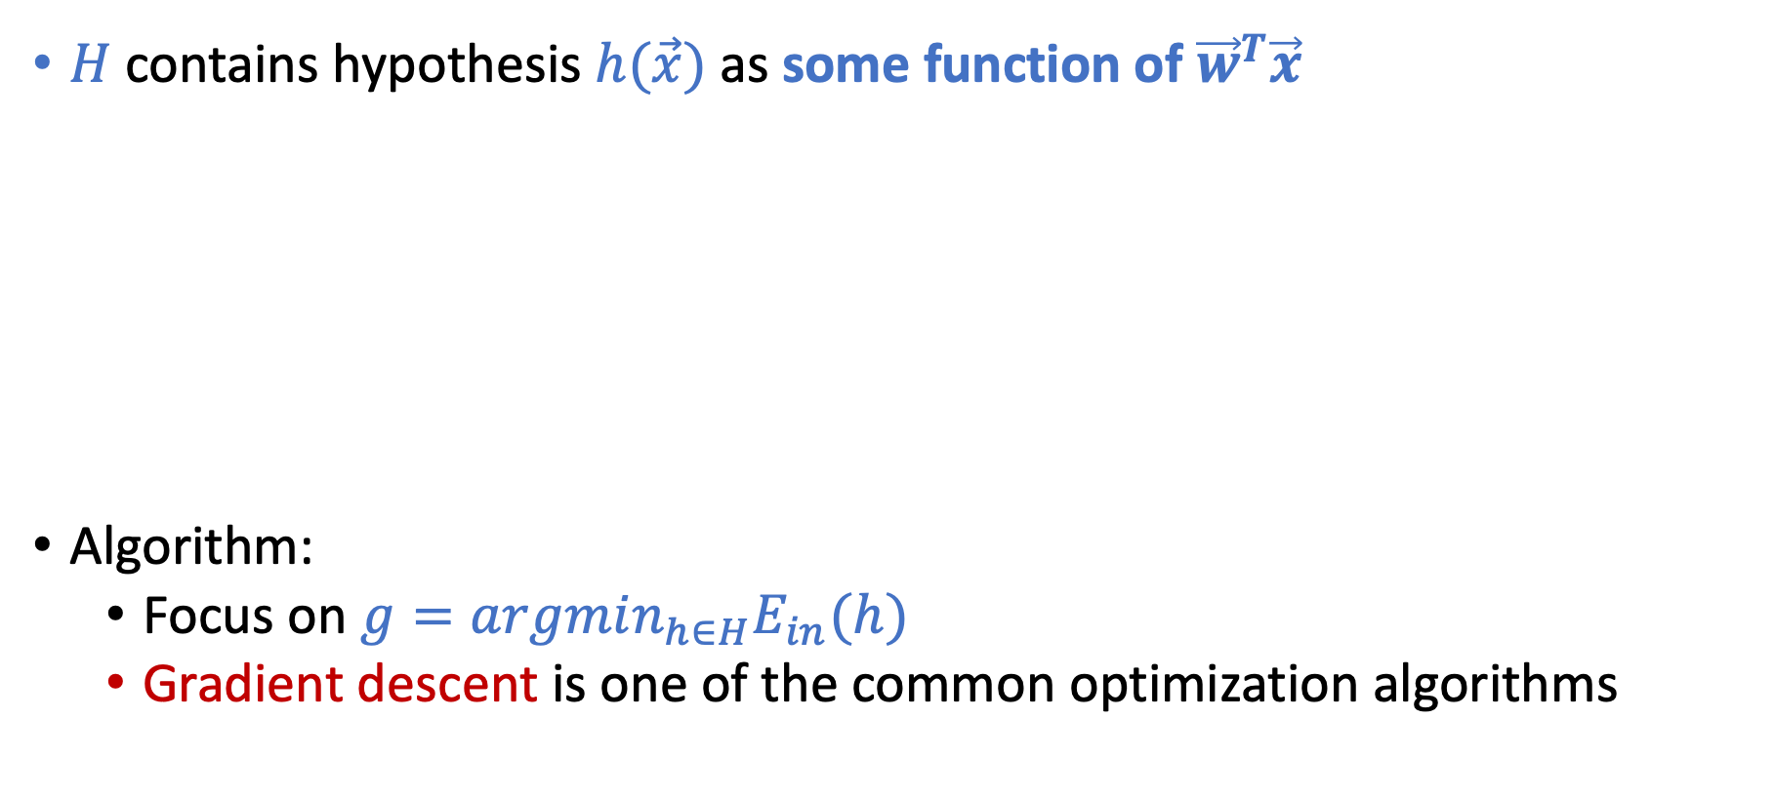
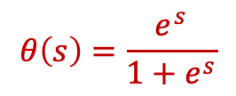
Linear Models
This is why it’s called linear models
$H$ contains hypothesis $h(\vec{x})$ as some function of ${\vec{w}}^{T}\vec{x}$
Algorithm:
Focus on $g=argmin_{h∈H}E_{in}(h)$
Gradient descent is one of the common optimization algorithms
 | Domain | Model
Linear Classification | $$y∈\{−1,+1\}$$ | $$H=\{h\left(\vec{x}\right)={sign(\vec{w}}^{T}\vec{x})\}$$
Linear Regression | $$y∈ℝ$$ | $$H=\{h\left(\vec{x}\right)={\vec{w}}^{T}\vec{x}\}$$
Logistic Regression | $y∈$ $[0,1]$ | $$H=\{h\left(\vec{x}\right)={θ(\vec{w}}^{T}\vec{x})\}$$
Credit Card Example
Approve or not
Credit line
Prob. of default
$$θ\left(s\right)=\frac{e^{s}}{1+e^{s}}$$

Slide 5
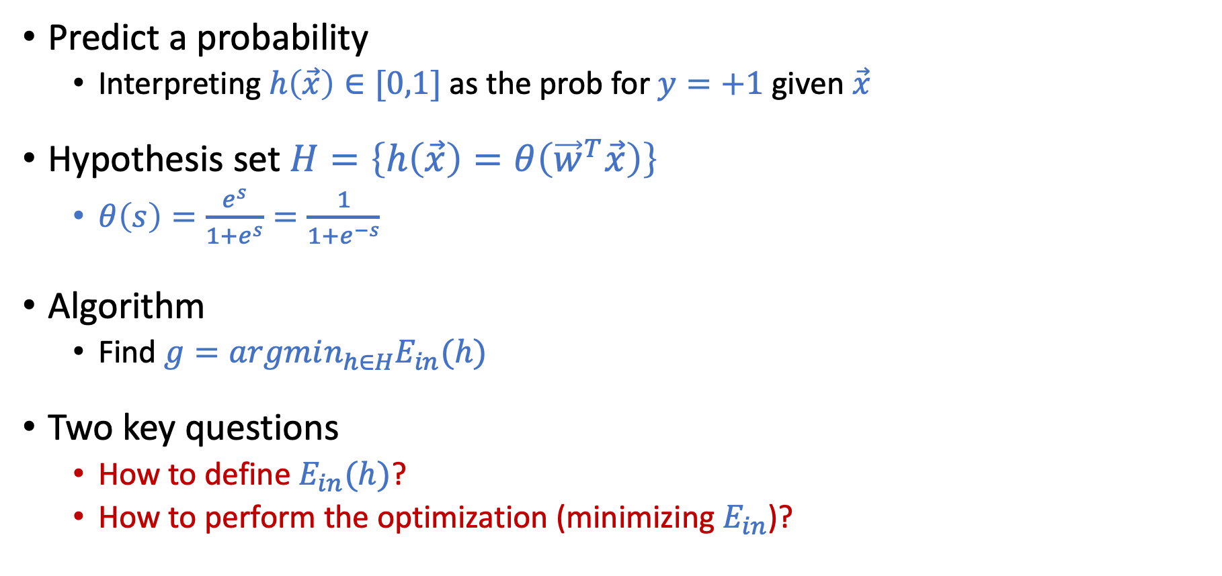
Logistic Regression
Predict a probability
Interpreting $h\left(\vec{x}\right)∈[0,1]$ as the prob for $y=+1$ given $\vec{x}$
Hypothesis set $H=\left\{h\left(\vec{x}\right)=θ\left({\vec{w}}^{T}\vec{x}\right)\right\}$
$θ\left(s\right)=\frac{e^{s}}{1+e^{s}}=\frac{1}{1+e^{−s}}$
Algorithm
Find $g=argmin_{h∈H}E_{in}(h)$
Two key questions
How to define $E_{in}(h)$?
How to perform the optimization (minimizing $E_{in}$)?

Slide 6
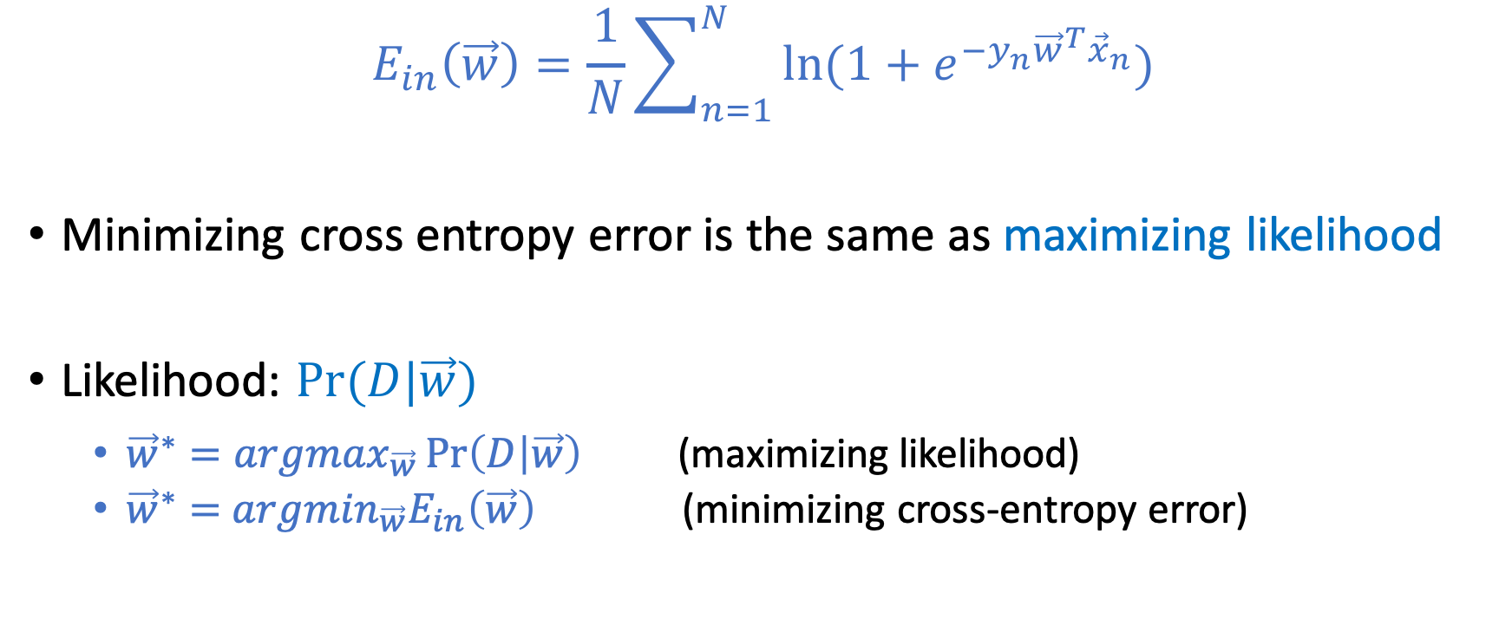

Define $E_{in}\left(\vec{w}\right):$ Cross-Entropy Error
$$E_{in}\left(\vec{w}\right)=\frac{1}{N}\sum_{n=1}^{N}{\ln{(1+e^{−y_{n}{\vec{w}}^{T}{\vec{x}}_{n}})}}$$
Minimizing cross entropy error is the same as maximizing likelihood
Likelihood: $Pr⁡(D|\vec{w})$
${\vec{w}}^{∗}=argmax_{\vec{w}}\operatorname{Pr}\left(D | \vec{w}\right)$ (maximizing likelihood)
${\vec{w}}^{∗}=$ $argmin_{\vec{w}}E_{in}\left(\vec{w}\right)$ (minimizing cross-entropy error)

Slide 7
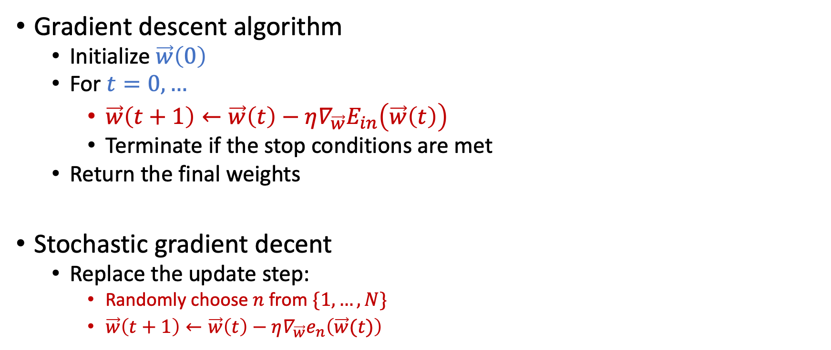

Optimizing $E_{in}\left(\vec{w}\right)$: Gradient Descent
Gradient descent algorithm
Initialize $\vec{w}\left(0\right)$
For $t=0,…$
$\vec{w}\left(t+1\right)←\vec{w}\left(t\right)−η∇_{\vec{w}}E_{in}\left(\vec{w}\left(t\right)\right)$
Terminate if the stop conditions are met
Return the final weights
Stochastic gradient decent
Replace the update step:
Randomly choose $n$ from $\{1,…,N\}$
$\vec{w}\left(t+1\right)←\vec{w}\left(t\right)−η∇_{\vec{w}}e_{n}\left(\vec{w}(t)\right)$
Works for functions where gradient exists everywhere
Notes for homework 2:
Please use “non-stochastic” gradient descent
Check vectorization to speed up your implementation

Slide 8
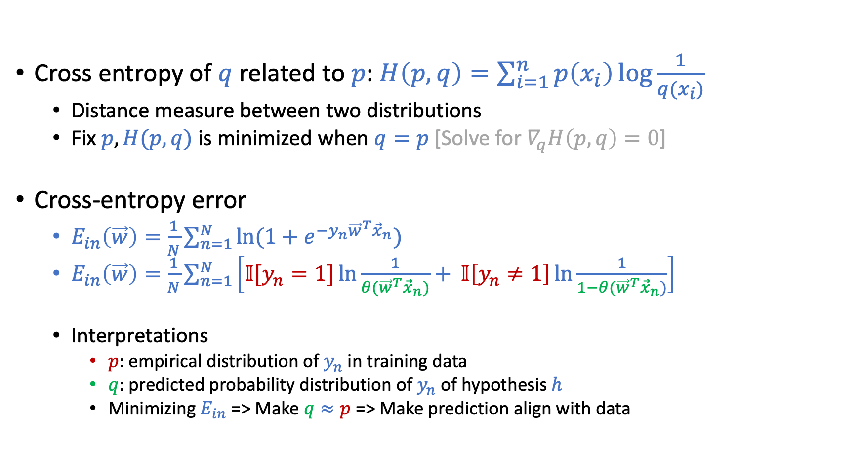
More on Cross Entropy [This Page is Safe to Skip]
Cross entropy of $q$ related to $p$: $H\left(p,q\right)=\sum_{i=1}^{n}{p\left(x_{i}\right)\log{\frac{1}{q(x_{i})}}}$
Distance measure between two distributions
Fix $p, H(p,q)$ is minimized when $q=p$ [Solve for $∇_{q}H\left(p,q\right)=0$]
Cross-entropy error
$E_{in}\left(\vec{w}\right)=\frac{1}{N}\sum_{n=1}^{N}{\ln{(1+e^{−y_{n}{\vec{w}}^{T}{\vec{x}}_{n}})}}$
$E_{in}\left(\vec{w}\right)=\frac{1}{N}\sum_{n=1}^{N}{\left[𝕀[y_{n}=1]\ln{\frac{1}{θ({\vec{w}}^{T}{\vec{x}}_{n})}+} 𝕀\left[y_{n}≠1\right]\ln{\frac{1}{1−θ({\vec{w}}^{T}{\vec{x}}_{n})}}\right]}$
Interpretations
$p:$empirical distribution of $y_{n}$ in training data
$q:$ predicted probability distribution of $y_{n}$ of hypothesis $h$
Minimizing $E_{in}$ => Make $q≈p$ => Make prediction align with data

Slide 9
Today’s Lecture
The notes are not intended to be comprehensive. They should be accompanied by lectures and/or textbook.
Let me know if you spot errors.

Slide 10
Limitations of Linear Models

Slide 11
Non-Linear Transformation

Slide 12
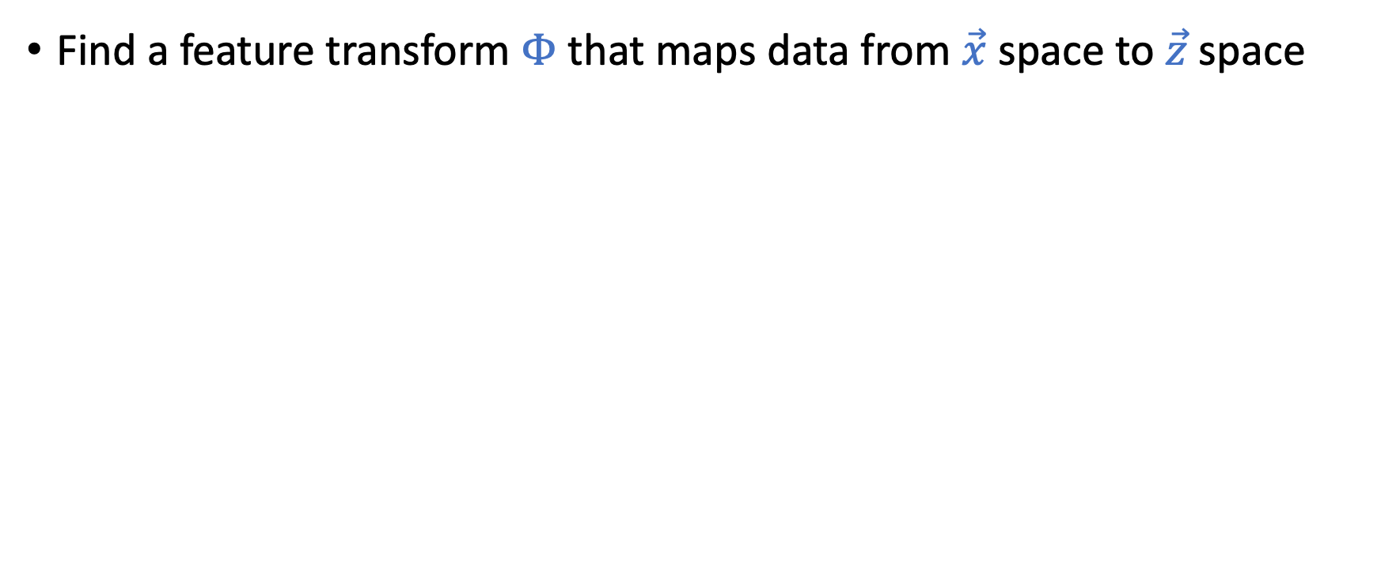
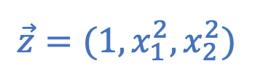
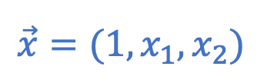
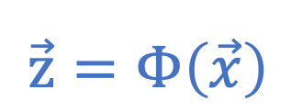
Using Non-Linear Transformations
Find a feature transform $Φ$ that maps data from $\vec{x}$ space to $\vec{z}$ space
$$\vec{z}=Φ\left(\vec{x}\right)$$
$$\vec{x}=(1,x_{1},x_{2})$$
$$\vec{z}=(1,x_{1}^{2},x_{2}^{2})$$

Slide 13
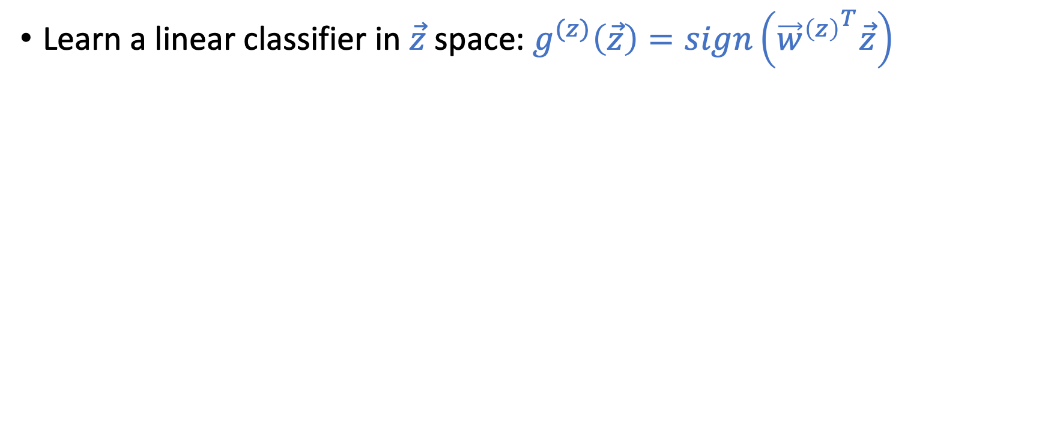
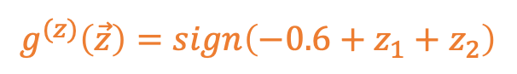
Using Non-Linear Transformations
Learn a linear classifier in $\vec{z}$ space: $g^{(z)}\left(\vec{z}\right)=sign\left({{\vec{w}}^{\left(z\right)}}^{T}\vec{z}\right)$
$$\vec{z}=Φ\left(\vec{x}\right)$$
$$\vec{x}=(1,x_{1},x_{2})$$
$$\vec{z}=(1,x_{1}^{2},x_{2}^{2})$$
$$g^{(z)}\left(\vec{z}\right)=sign\left(−0.6+z_{1}+z_{2}\right)$$

Slide 14
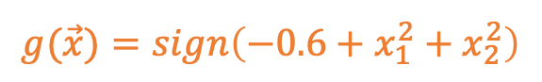
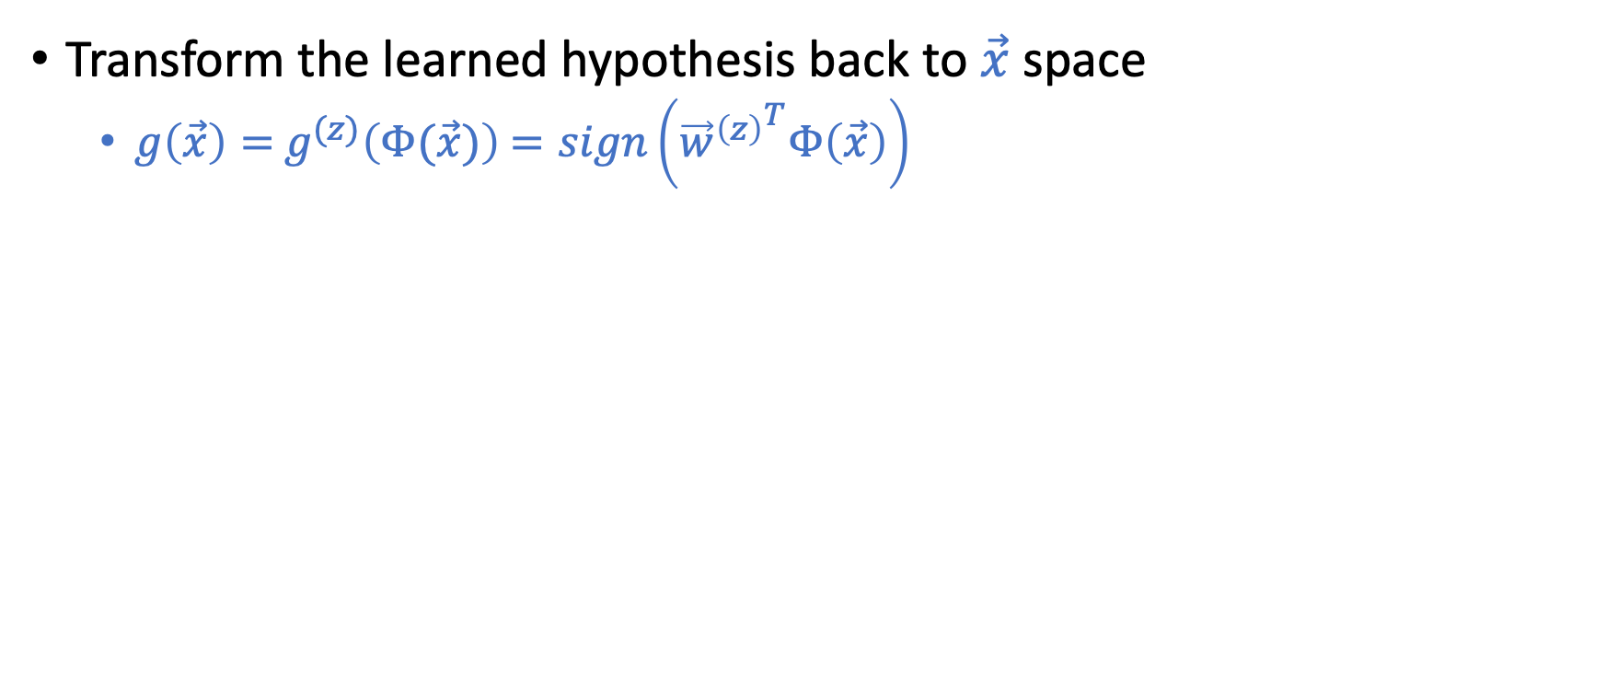
Using Non-Linear Transformations
Transform the learned hypothesis back to $\vec{x}$ space
$g\left(\vec{x}\right)=$ $g^{(z)}\left(Φ(\vec{x})\right)$ $=sign\left({{\vec{w}}^{\left(z\right)}}^{T}Φ\left(\vec{x}\right)\right)$
$$\vec{x}=(1,x_{1},x_{2})$$
$$\vec{z}=(1,x_{1}^{2},x_{2}^{2})$$
$$g(\vec{x})=sign\left(−0.6+x_{1}^{2}+x_{2}^{2}\right)$$
$$g^{(z)}\left(\vec{z}\right)=sign\left(−0.6+z_{1}+z_{2}\right)$$

Slide 15
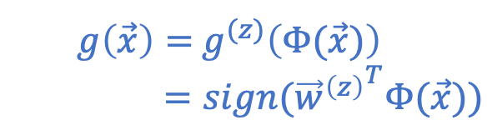
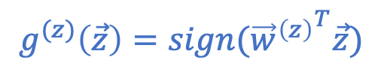
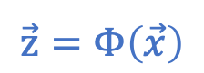
Nonlinear Transformation
$$\vec{z}=Φ\left(\vec{x}\right)$$
$$g^{(z)}\left(\vec{z}\right)=sign({{\vec{w}}^{\left(z\right)}}^{T}\vec{z})$$
$g\left(\vec{x}\right)=$ $g^{(z)}\left(Φ(\vec{x})\right)$
$=sign({{\vec{w}}^{\left(z\right)}}^{T}Φ(\vec{x}))$

Slide 16
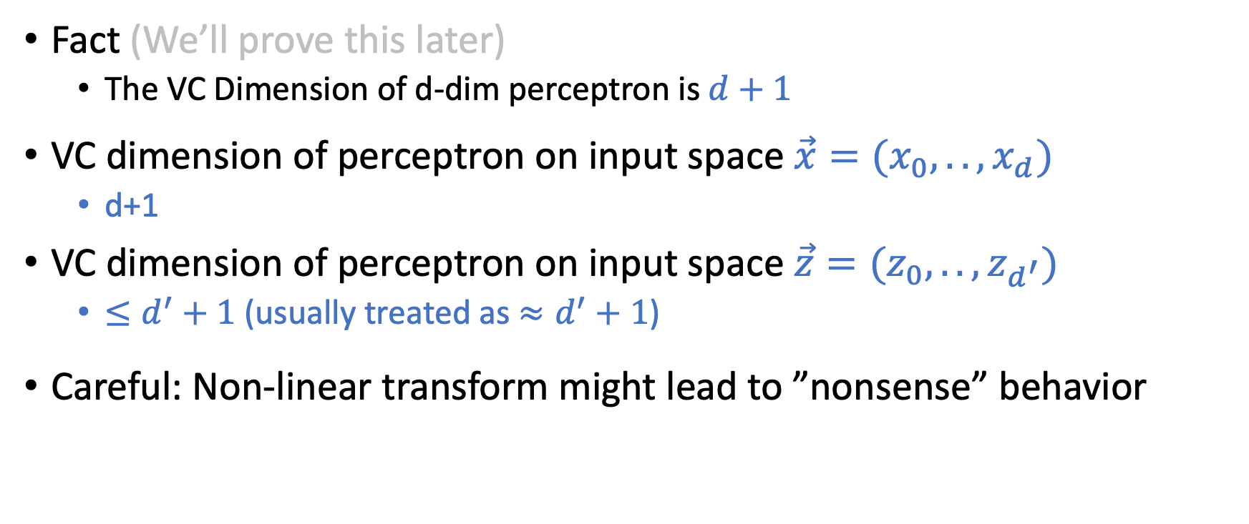
Generalization of Nonlinear Transformation
Fact (We’ll prove this later)
The VC Dimension of d-dim perceptron is $d+1$
VC dimension of perceptron on input space $\vec{x}=(x_{0},..,x_{d})$
d+1
VC dimension of perceptron on input space $\vec{z}=(z_{0},..,z_{d^{′}})$
$≤d^{′}+1$(usually treated as $≈d^{′}+1$)
Careful: Non-linear transform might lead to ”nonsense” behavior

Slide 17

How to Choose Feature Transform $Φ$

Slide 18
How to Choose Feature Transform $Φ$
Something Seems Wrong!

Slide 19
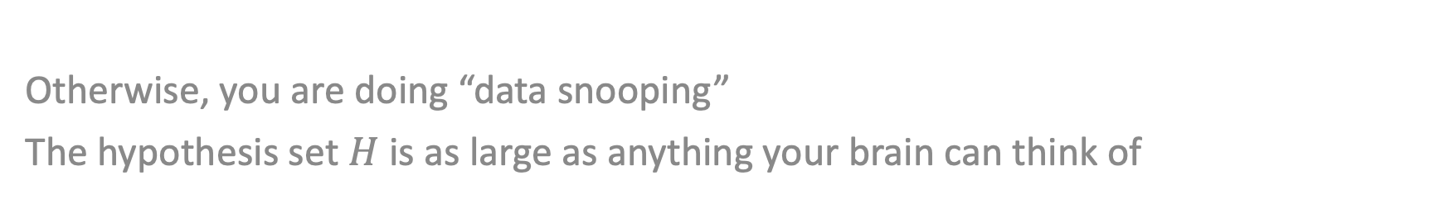

Must choose $Φ$ BEFORE looking at the data
Otherwise, you are doing “data snooping”
The hypothesis set $H$ is as large as anything your brain can think of

Slide 20
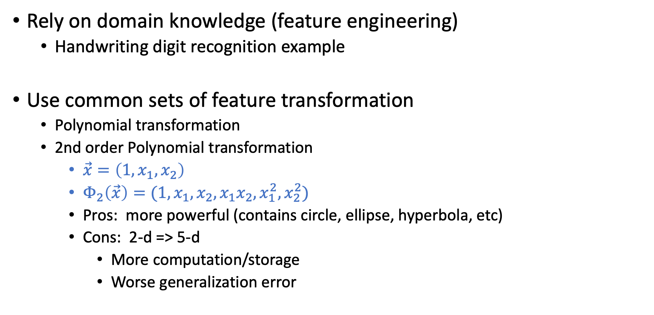

Choose $Φ$ Before Seeing Data
Rely on domain knowledge (feature engineering)
Handwriting digit recognition example
Use common sets of feature transformation
Polynomial transformation
2nd order Polynomial transformation
$\vec{x}=\left(1,x_{1},x_{2}\right)$
$Φ_{2}\left(\vec{x}\right)=(1,x_{1},x_{2},x_{1}x_{2},x_{1}^{2},x_{2}^{2})$
Pros: more powerful (contains circle, ellipse, hyperbola, etc)
Cons: 2-d => 5-d
More computation/storage
Worse generalization error
The VC dimension of d-dim perceptron is d+1

Slide 21
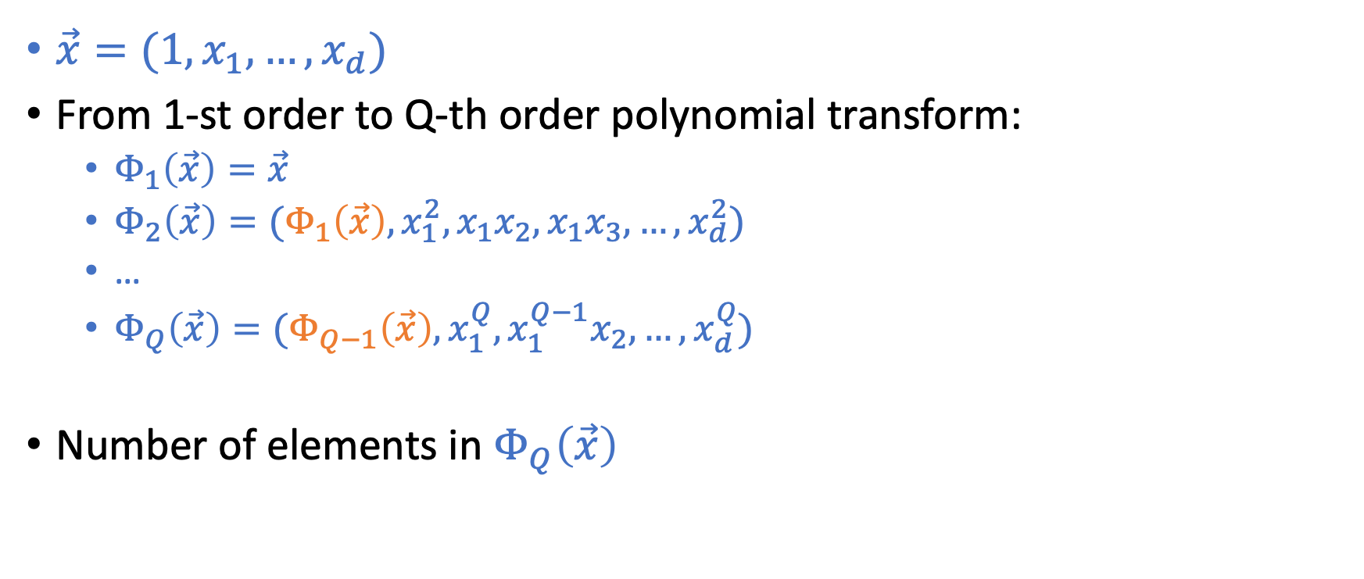
Q-th Order Polynomial Transform
$\vec{x}=(1,x_{1},…,x_{d})$
From 1-st order to Q-th order polynomial transform:
$Φ_{1}\left(\vec{x}\right)=\vec{x}$
$Φ_{2}\left(\vec{x}\right)=(Φ_{1}\left(\vec{x}\right),x_{1}^{2},x_{1}x_{2},x_{1}x_{3},…,x_{d}^{2})$
…
$Φ_{Q}\left(\vec{x}\right)=(Φ_{Q−1}\left(\vec{x}\right),x_{1}^{Q},x_{1}^{Q−1}x_{2},…,x_{d}^{Q})$
Number of elements in $Φ_{Q}\left(\vec{x}\right)$

Slide 22
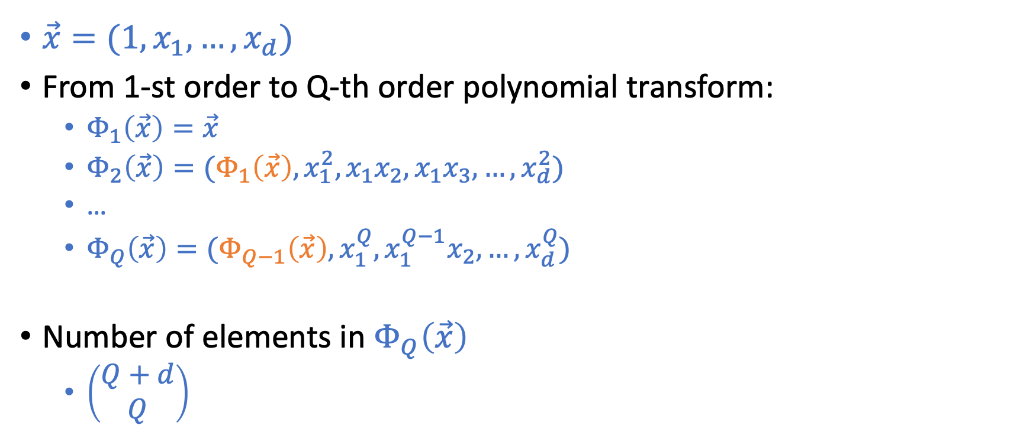
Q-th Order Polynomial Transform
$\vec{x}=(1,x_{1},…,x_{d})$
From 1-st order to Q-th order polynomial transform:
$Φ_{1}\left(\vec{x}\right)=\vec{x}$
$Φ_{2}\left(\vec{x}\right)=(Φ_{1}\left(\vec{x}\right),x_{1}^{2},x_{1}x_{2},x_{1}x_{3},…,x_{d}^{2})$
…
$Φ_{Q}\left(\vec{x}\right)=(Φ_{Q−1}\left(\vec{x}\right),x_{1}^{Q},x_{1}^{Q−1}x_{2},…,x_{d}^{Q})$
Number of elements in $Φ_{Q}\left(\vec{x}\right)$
$\left(\begin{matrix}Q+d \\ Q\end{matrix}\right)$

Slide 23
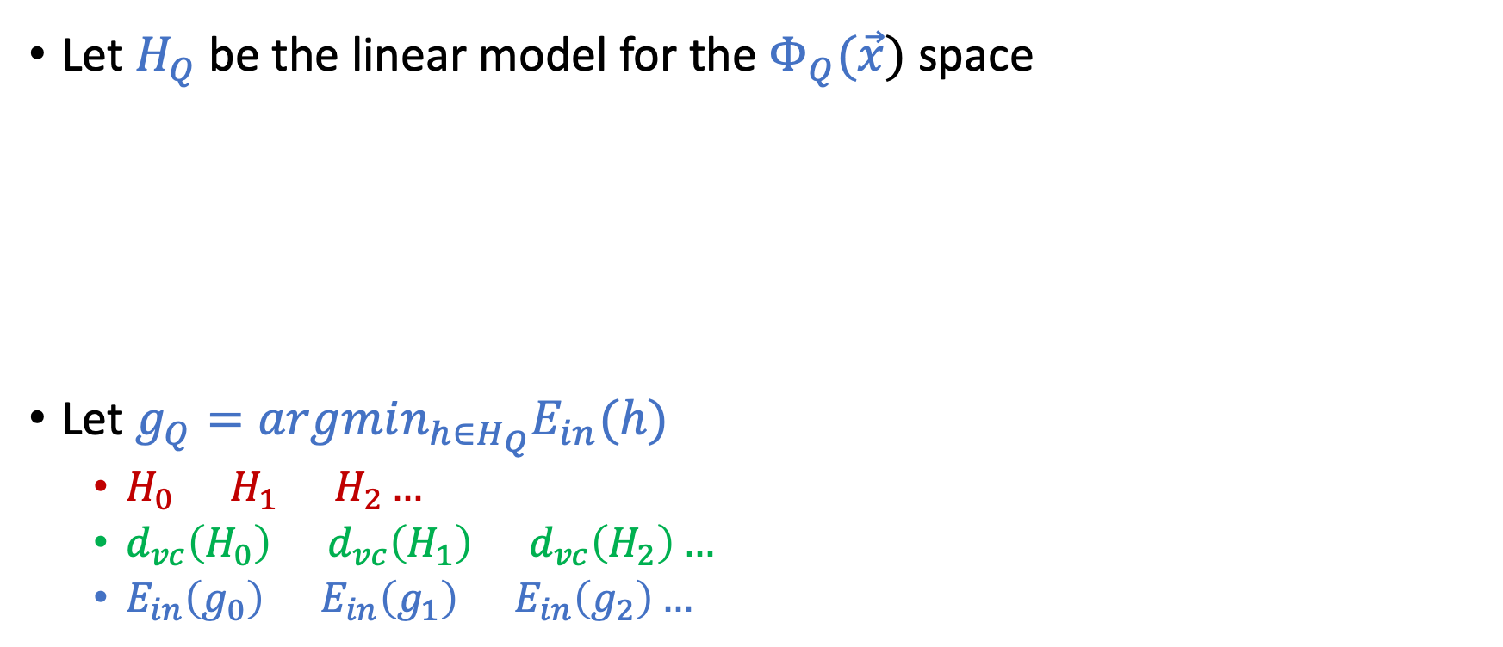
Structural Hypothesis Sets
Let $H_{Q}$ be the linear model for the $Φ_{Q}(\vec{x})$ space
Let $g_{Q}=argmin_{h∈H_{Q}}E_{in}(h)$
$H_{0}⊂H_{1}⊂H_{2}…$
$d_{vc}\left(H_{0}\right)≤d_{vc}\left(H_{1}\right)≤d_{vc}\left(H_{2}\right)…$
$E_{in}\left(g_{0}\right)≥E_{in}\left(g_{1}\right)≥E_{in}\left(g_{2}\right)…$

Slide 24
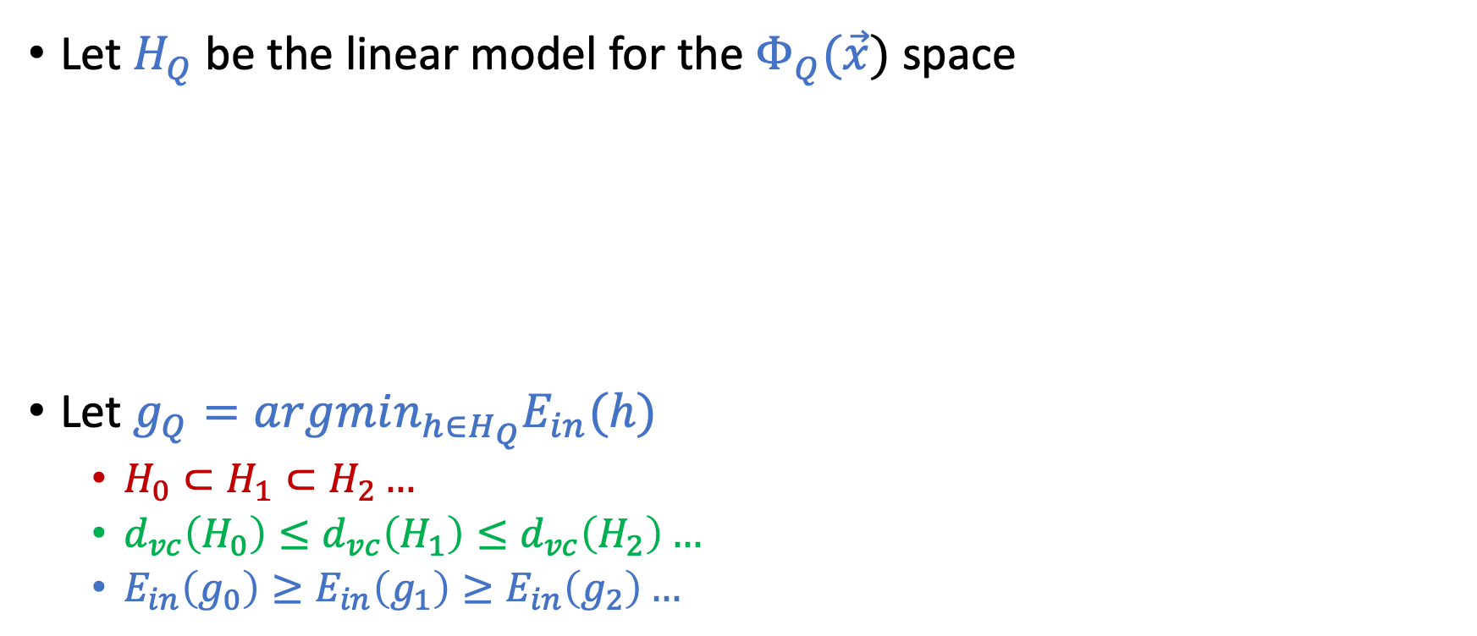
Structural Hypothesis Sets
Let $H_{Q}$ be the linear model for the $Φ_{Q}(\vec{x})$ space
Let $g_{Q}=argmin_{h∈H_{Q}}E_{in}(h)$
$H_{0}⊂H_{1}⊂H_{2}…$
$d_{vc}\left(H_{0}\right)≤d_{vc}\left(H_{1}\right)≤d_{vc}\left(H_{2}\right)…$
$E_{in}\left(g_{0}\right)≥E_{in}\left(g_{1}\right)≥E_{in}\left(g_{2}\right)…$

Slide 25
Overfitting
[Adapted from the slides by Malik Magdon-Ismail]

Slide 26
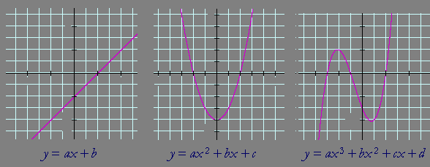
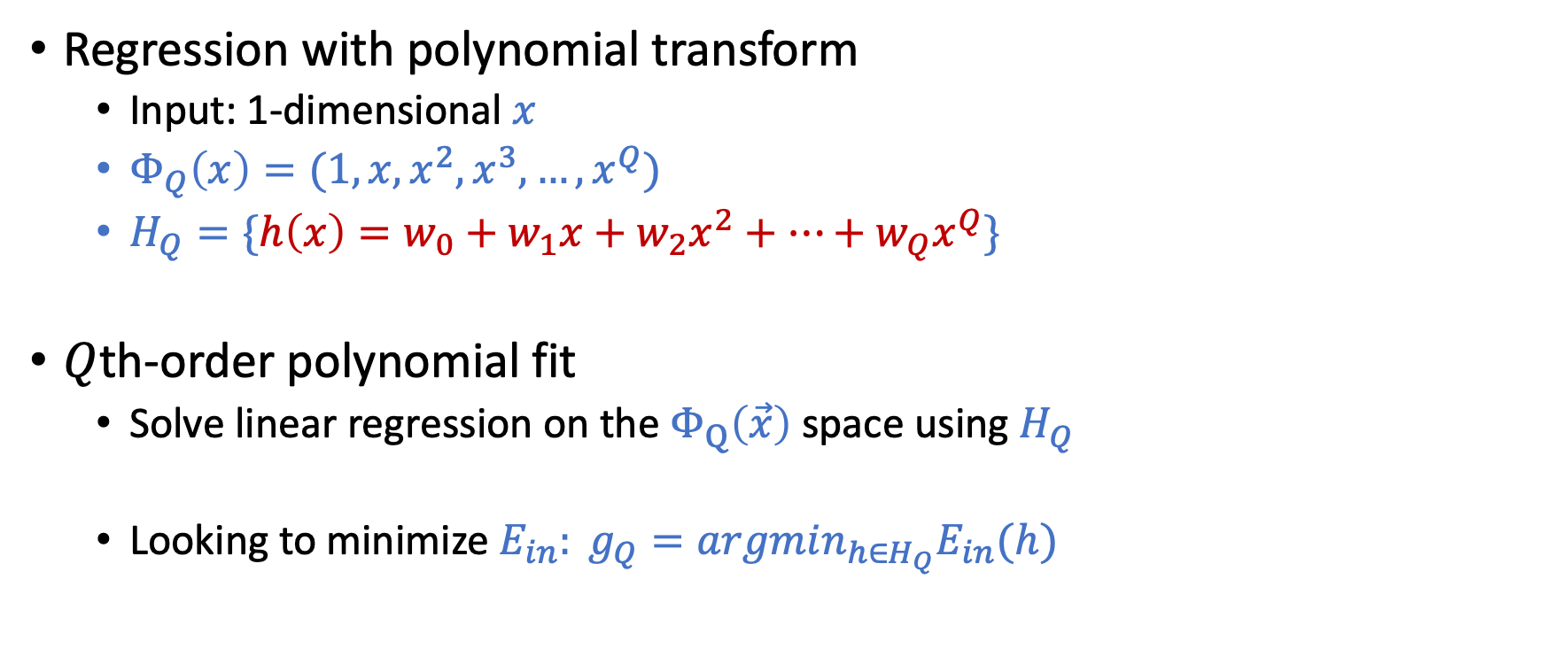
Setup of the Discussion
Regression with polynomial transform
Input: 1-dimensional $x$
$Φ_{Q}\left(x\right)=(1,x,x^{2},x^{3},…,x^{Q})$
$H_{Q}=\{h\left(x\right)=w_{0}+w_{1}x+w_{2}x^{2}+…+w_{Q}x^{Q}\}$
$Q$th-order polynomial fit
Solve linear regression on the $Φ_{Q}\left(\vec{x}\right)$ space using $H_{Q}$
Looking to minimize $E_{in}: g_{Q}=argmin_{h∈H_{Q}}E_{in}(h)$

Slide 27
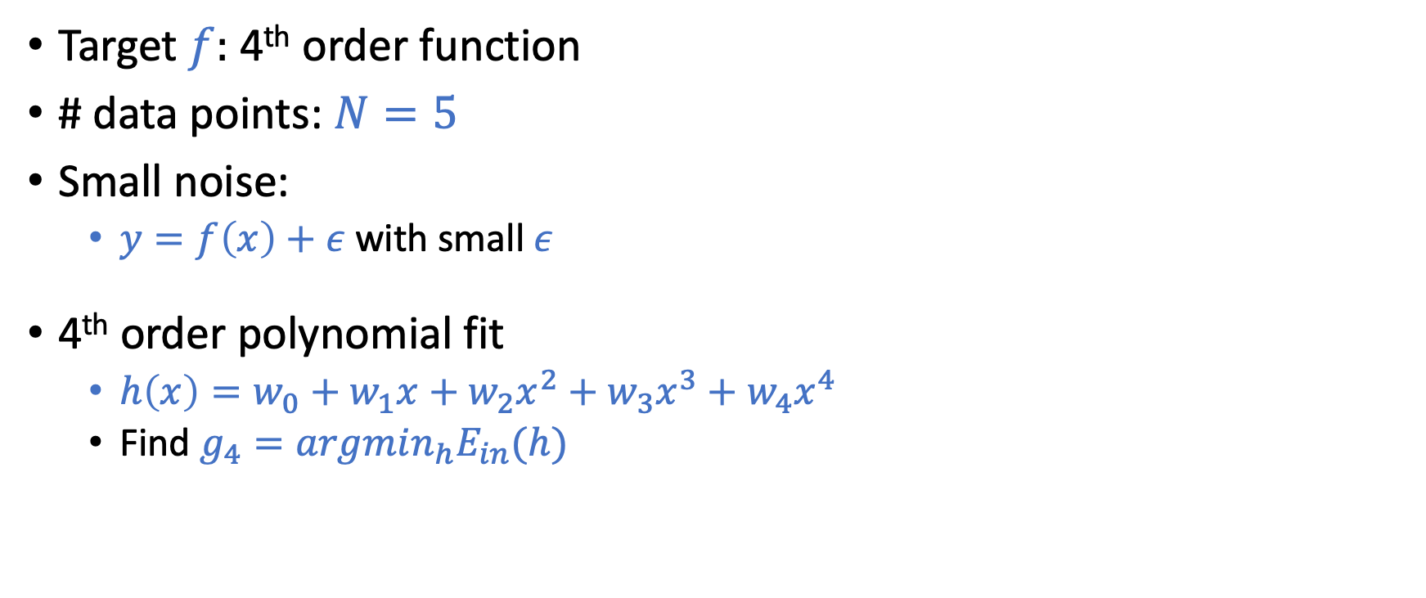
A Simple Example
Target $f:$ 4th order function
# data points: $N=5$
Small noise:
$y=f\left(x\right)+ε$ with small $ε$
4th order polynomial fit
$h\left(x\right)=w_{0}+w_{1}x+w_{2}x^{2}+w_{3}x^{3}+w_{4}x^{4}$
Find $g_{4}=argmin_{h}E_{in}(h)$

Slide 28
A Simple Example
Target $f:$ 4th order function
# data points: $N=5$
Small noise:
$y=f\left(x\right)+ε$ with small $ε$
4th order polynomial fit
$h\left(x\right)=w_{0}+w_{1}x+w_{2}x^{2}+w_{3}x^{3}+w_{4}x^{4}$
Find $g_{4}=argmin_{h}E_{in}(h)$
Classical overfitting: $E_{in}=0,$ but lead to a large $E_{out}$
Fitting the noise instead of the target

Slide 29
What is Overfitting?
Fitting the data more than is warranted

Slide 30
Overfitting is Not Just Bad Generalization

Slide 31

Overfitting is Not Just Bad Generalization
Overfitting
Going for lower and lower $E_{in}$ results in higher and higher $E_{out}$

Slide 32
Case Study: 2nd vs 10th Order Polynomial Fit

Slide 33
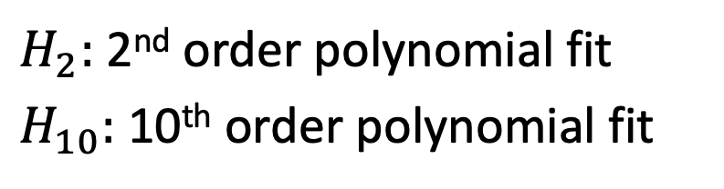
N=15
$H_{2}:$ 2nd order polynomial fit
$H_{10}:$ 10th order polynomial fit
Which model would you choose for the left problem and why?

Slide 34

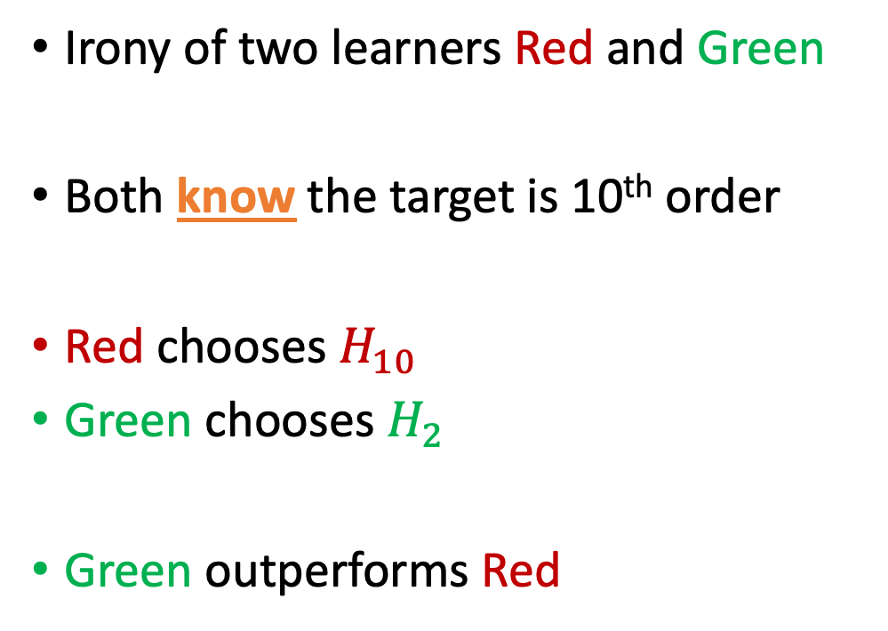
Target Function: 10th Order $f$ with Noise
Irony of two learners Red and Green
Both know the target is 10th order
Red chooses $H_{10}$
Green chooses $H_{2}$
Green outperforms Red

Slide 35


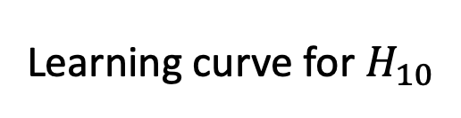
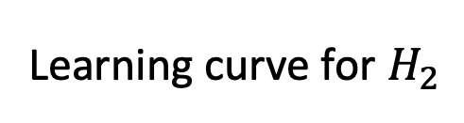
Why is $H_{2}$ Better than $H_{10}$?
Learning curve for $H_{2}$
Learning curve for $H_{10}$
When $N$ is small, $E_{out}\left(g_{10}\right)≥E_{out}(g_{2})$

Slide 36
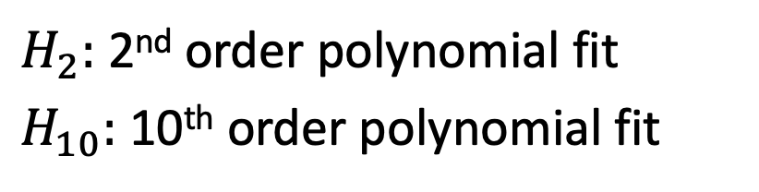
N=15
$H_{2}:$ 2nd order polynomial fit
$H_{10}:$ 10th order polynomial fit
Which model do you choose for the right problem and why?

Slide 37

Simpler $H$ is better even for complex target with no noise

Slide 38
Is There Really “No Noise”?

Slide 39
Is There Really “No Noise”?
$H$ should match quantity and quality of data, not $\left(unknown\right)f$

Slide 40
Why is $H_{2}$ Better than $H_{10}$?
Learning curve for $H_{2}$
Learning curve for $H_{10}$
When $N$ is small, $E_{out}\left(g_{10}\right)≥E_{out}(g_{2})$

Slide 41
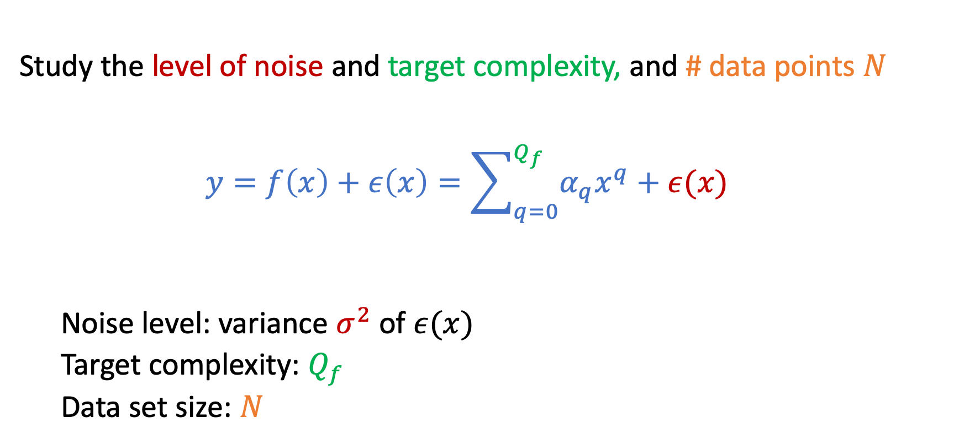
A Detailed Experiment
Study the level of noise and target complexity, and # data points $N$
$$y=f\left(x\right)+ε\left(x\right)=\sum_{q=0}^{Q_{f}}{α_{q}x^{q}+ε(x)}$$
Noise level: variance $σ^{2}$ of $ε(x)$
Target complexity: $Q_{f}$
Data set size: $N$

Slide 42
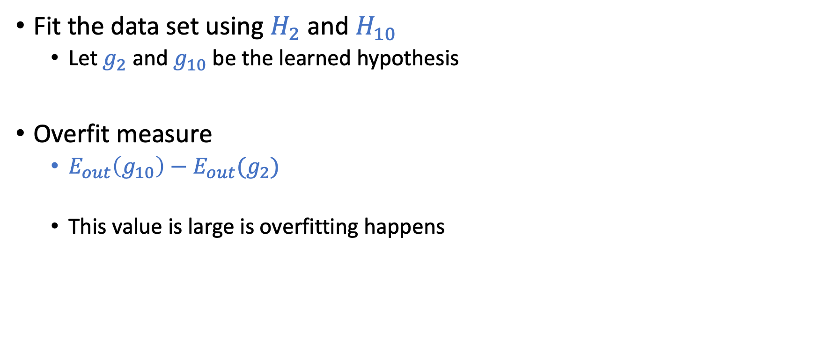
The Overfit Measure
Fit the data set using $H_{2}$ and $H_{10}$
Let $g_{2}$ and $g_{10}$ be the learned hypothesis
Overfit measure
$E_{out}\left(g_{10}\right)−E_{out}(g_{2})$
This value is large is overfitting happens

Slide 43

Overfit Measure: $E_{out}\left(g_{10}\right)−E_{out}(g_{2})$
Stochastic noise
deterministic noise

Slide 44
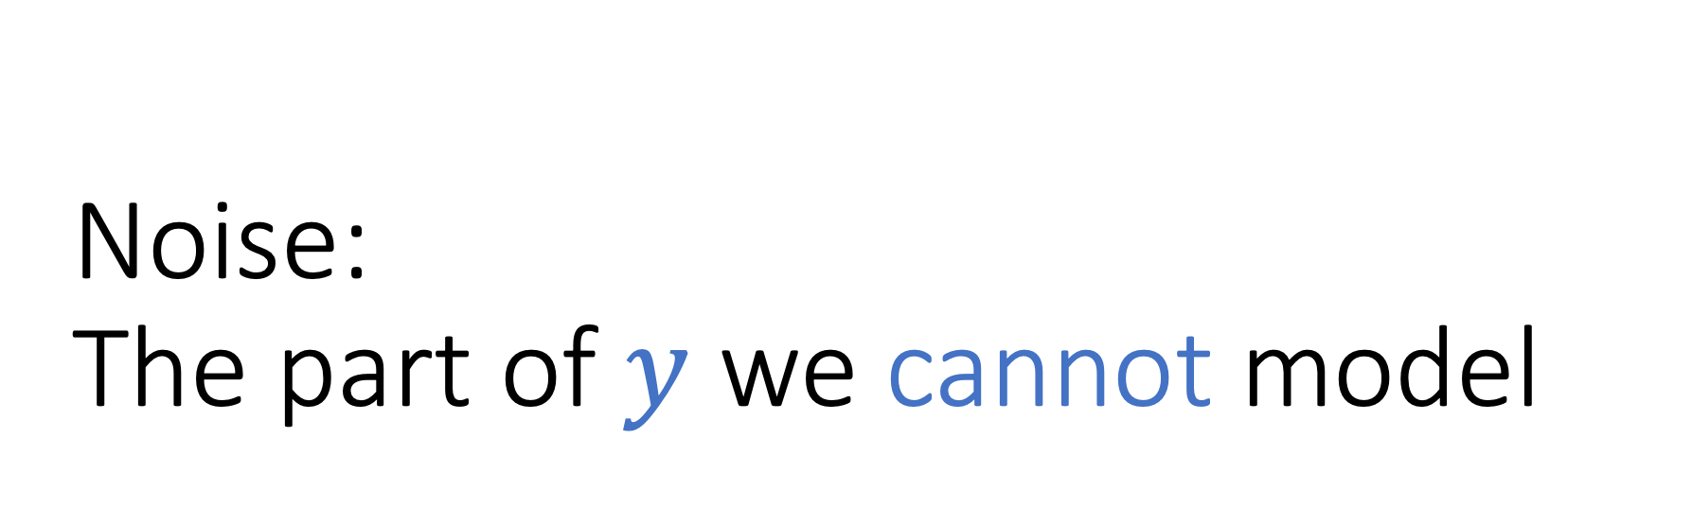
Noise: The part of $y$ we cannot model

Slide 45
Stochastic Noise

Slide 46
Stochastic Noise

Slide 47
Deterministic Noise

Slide 48
Deterministic Noise

Slide 49
Both sources of noises hurt learning

Slide 50
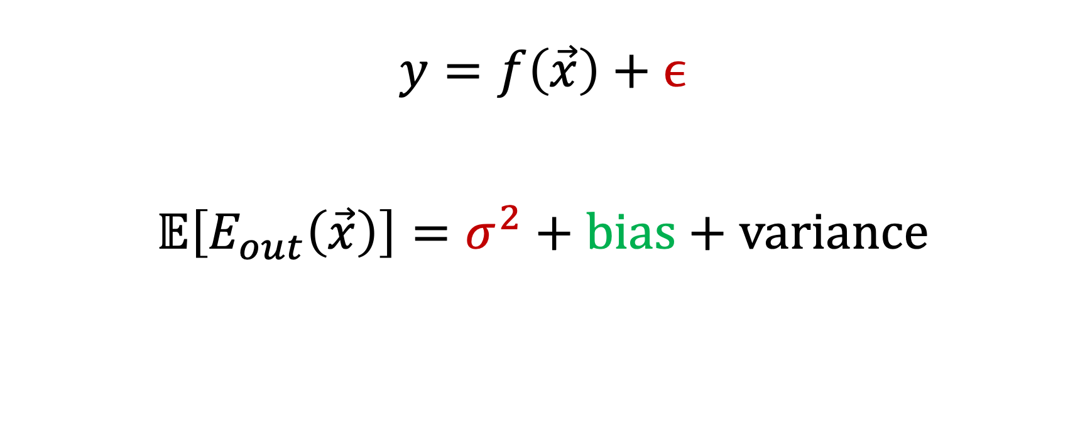
Noise and Bias-Variance Decomposition
$$y=f\left(\vec{x}\right)+ϵ$$
$$𝔼\left[E_{out}\left(\vec{x}\right)\right]=σ^{2}+\text{bias}+\text{variance}$$
Stochastic Noise
Deterministic noise

Slide 51
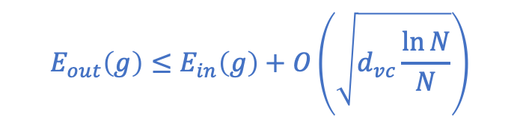
How to Fight Overfitting
VC Bound
Fighting overfitting
Regularization
Validation
(The focus of the next two lectures)
$$E_{out}\left(g\right)≤E_{in}\left(g\right)+O\left(\sqrt{d_{vc}\frac{\ln{N}}{N}}\right)$$

Slide 52
VC Dimension of d-dim Perceptron

Slide 53
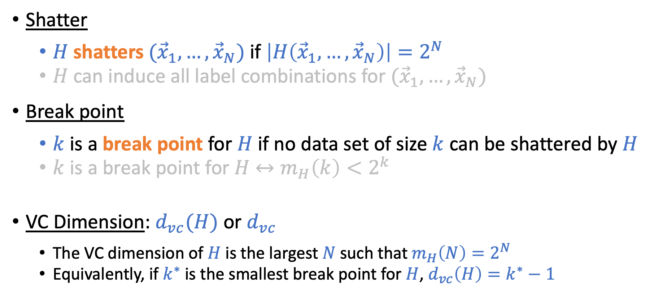
Recall the Definitions
Shatter
$H$ shatters $({\vec{x}}_{1},…,{\vec{x}}_{N})$ if $\left|H\left({\vec{x}}_{1},…,{\vec{x}}_{N}\right)\right|=2^{N}$
$H$ can induce all label combinations for $({\vec{x}}_{1},…,{\vec{x}}_{N})$
Break point
$k$ is a break point for $H$ if no data set of size $k$ can be shattered by $H$
$k$ is a break point for $H$ $↔m_{H}\left(k\right)<2^{k}$
VC Dimension: $d_{vc}(H)$ or $d_{vc}$
The VC dimension of $H$ is the largest $N$ such that $m_{H}\left(N\right)=2^{N}$
Equivalently, if $k^{∗}$ is the smallest break point for $H$, $d_{vc}\left(H\right)=k^{∗}−1$

Slide 54
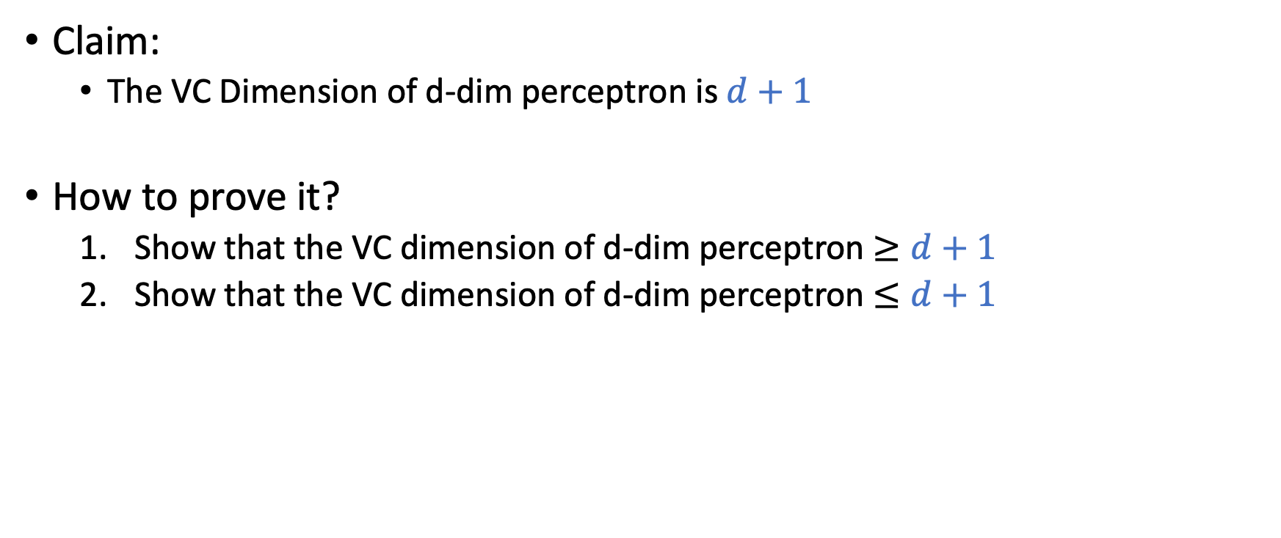
VC Dimension of d-dimension Perceptron
Claim:
The VC Dimension of d-dim perceptron is $d+1$
How to prove it?
Show that the VC dimension of d-dim perceptron $≥d+1$
Show that the VC dimension of d-dim perceptron $≤d+1$

Slide 55
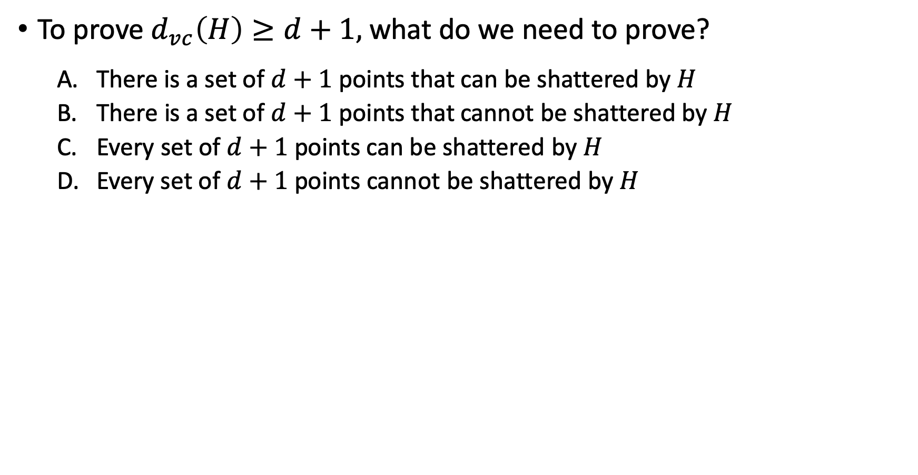
To prove $d_{vc}\left(H\right)≥d+1,$ what do we need to prove?
There is a set of $d+1$points that can be shattered by $H$
There is a set of $d+1$points that cannot be shattered by $H$
Every set of $d+1$ points can be shattered by $H$
Every set of $d+1$ points cannot be shattered by $H$

Slide 56
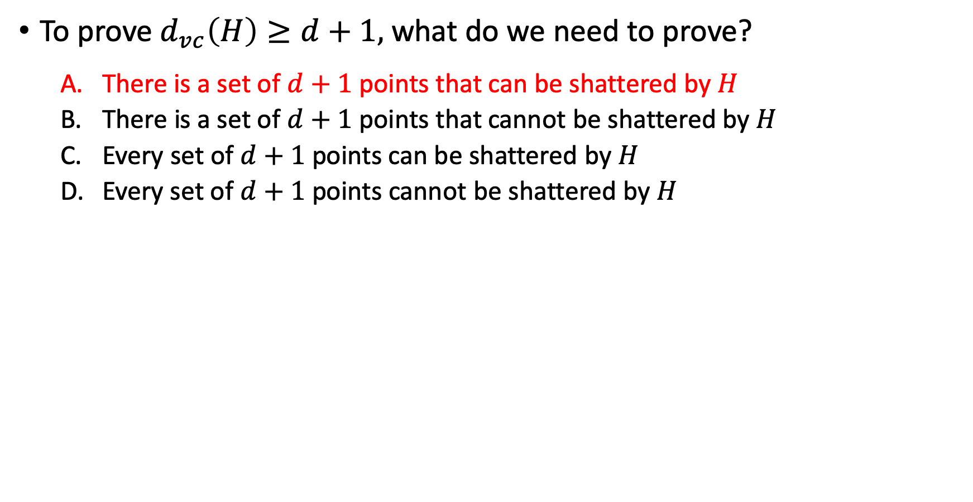
To prove $d_{vc}\left(H\right)≥d+1,$ what do we need to prove?
There is a set of $d+1$points that can be shattered by $H$
There is a set of $d+1$points that cannot be shattered by $H$
Every set of $d+1$ points can be shattered by $H$
Every set of $d+1$ points cannot be shattered by $H$

Slide 57
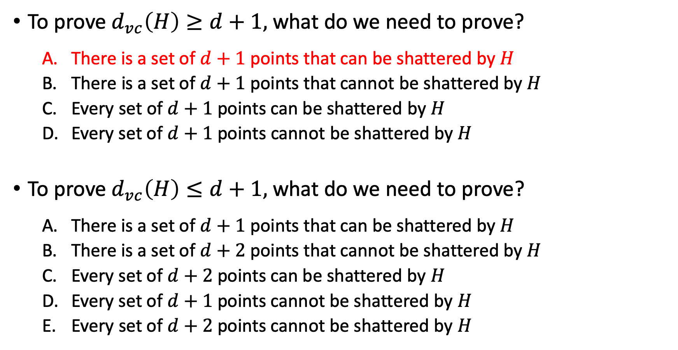
To prove $d_{vc}\left(H\right)≥d+1,$ what do we need to prove?
There is a set of $d+1$points that can be shattered by $H$
There is a set of $d+1$points that cannot be shattered by $H$
Every set of $d+1$ points can be shattered by $H$
Every set of $d+1$ points cannot be shattered by $H$
To prove $d_{vc}\left(H\right)≤d+1,$ what do we need to prove?
There is a set of $d+1$points that can be shattered by $H$
There is a set of $d+2$points that cannot be shattered by $H$
Every set of $d+2$ points can be shattered by $H$
Every set of $d+1$ points cannot be shattered by $H$
Every set of $d+2$ points cannot be shattered by $H$

Slide 58
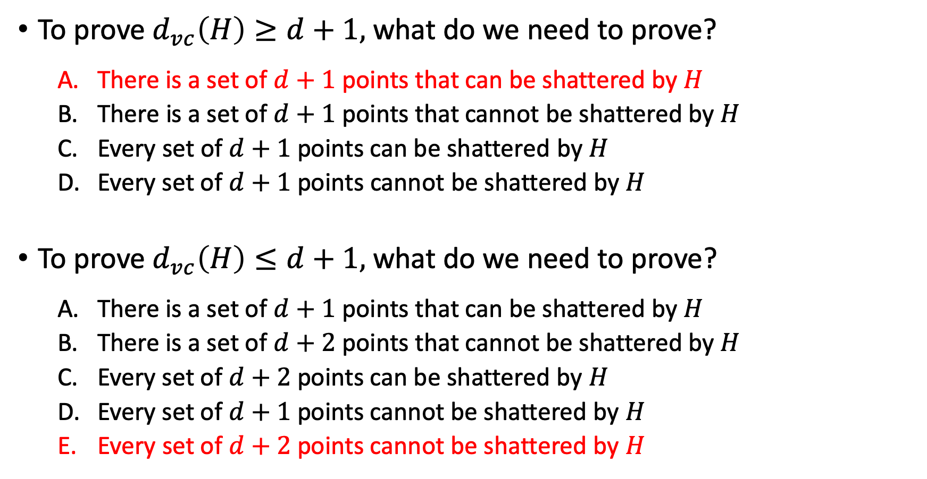
To prove $d_{vc}\left(H\right)≥d+1,$ what do we need to prove?
There is a set of $d+1$points that can be shattered by $H$
There is a set of $d+1$points that cannot be shattered by $H$
Every set of $d+1$ points can be shattered by $H$
Every set of $d+1$ points cannot be shattered by $H$
To prove $d_{vc}\left(H\right)≤d+1,$ what do we need to prove?
There is a set of $d+1$points that can be shattered by $H$
There is a set of $d+2$points that cannot be shattered by $H$
Every set of $d+2$ points can be shattered by $H$
Every set of $d+1$ points cannot be shattered by $H$
Every set of $d+2$ points cannot be shattered by $H$

Slide 59
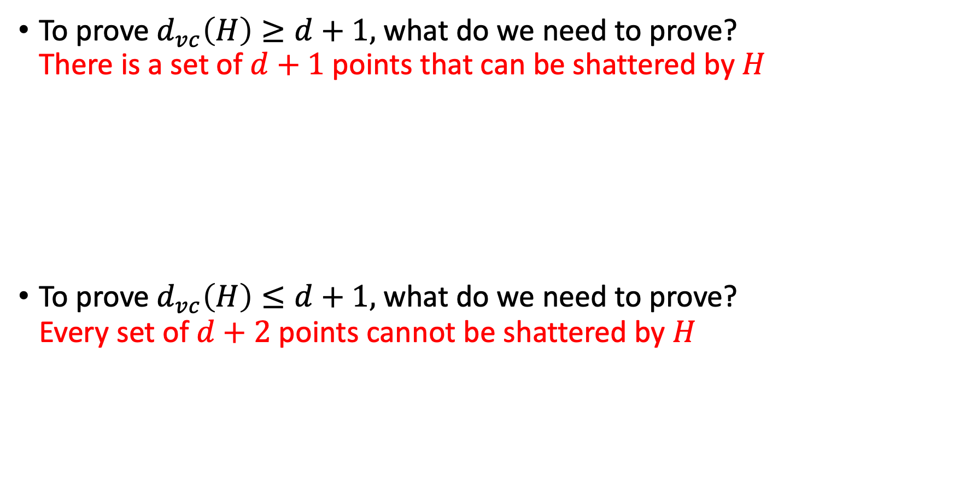
To prove $d_{vc}\left(H\right)≥d+1,$ what do we need to prove? There is a set of $d+1$points that can be shattered by $H$
To prove $d_{vc}\left(H\right)≤d+1,$ what do we need to prove? Every set of $d+2$ points cannot be shattered by $H$

Slide 60
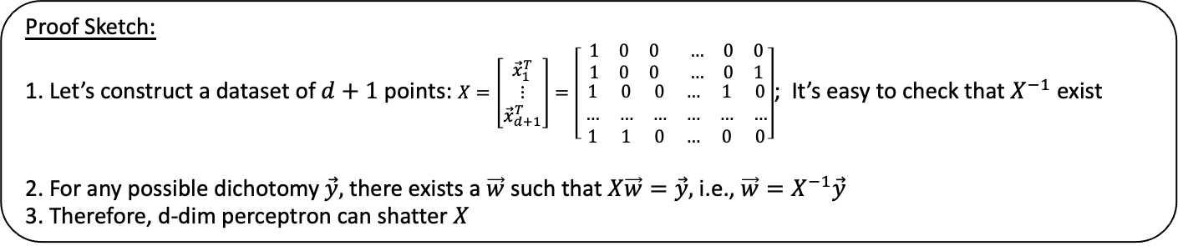
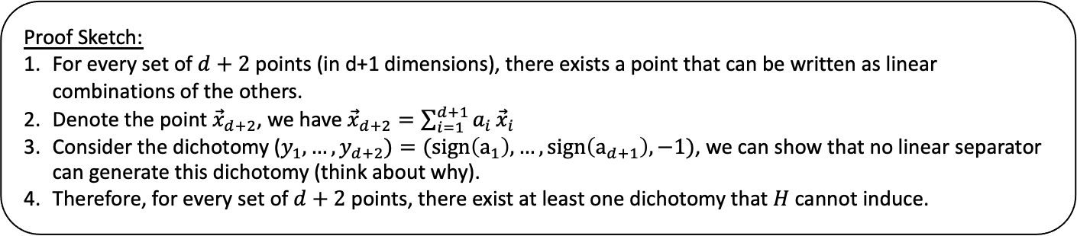
To prove $d_{vc}\left(H\right)≥d+1,$ what do we need to prove? There is a set of $d+1$points that can be shattered by $H$
To prove $d_{vc}\left(H\right)≤d+1,$ what do we need to prove? Every set of $d+2$ points cannot be shattered by $H$
Proof Sketch:
1. Let’s construct a dataset of $d+1$ points: $X=\left[\begin{matrix}{\vec{x}}_{1}^{T} \\ ⋮ \\ {\vec{x}}_{d+1}^{T}\end{matrix}\right]=\left[\begin{matrix}\begin{matrix}1 & 0 & 0 \\ 1 & 0 & 0\end{matrix} & \begin{matrix}… & 0 & 0 \\ … & 0 & 1\end{matrix} \\ \begin{matrix} 1 & 0 & 0 \\ … & … & … \\ 1 & 1 & 0\end{matrix} & \begin{matrix}… & 1 & 0 \\ … & … & … \\ … & 0 & 0\end{matrix}\end{matrix}\right]$; It’s easy to check that $X^{−1}$ exist
2. For any possible dichotomy $\vec{y},$ there exists a $\vec{w}$ such that $X\vec{w}=\vec{y},$ i.e., $\vec{w}=X^{−1}\vec{y}$
3. Therefore, d-dim perceptron can shatter $X$
Proof Sketch:
For every set of $d+2$ points (in d+1 dimensions), there exists a point that can be written as linear combinations of the others.
Denote the point ${\vec{x}}_{d+2}$, we have ${\vec{x}}_{d+2}=\sum_{i=1}^{d+1}{a_{i}}{\vec{x}}_{i}$
Consider the dichotomy ($y_{1},…,y_{d+2})=(sign\left(a_{1}\right),…,sign\left(a_{d+1}\right), −1)$, we can show that no linear separator can generate this dichotomy (think about why).
Therefore, for every set of $d+2$ points, there exist at least one dichotomy that $H$ cannot induce.

